Slide 1





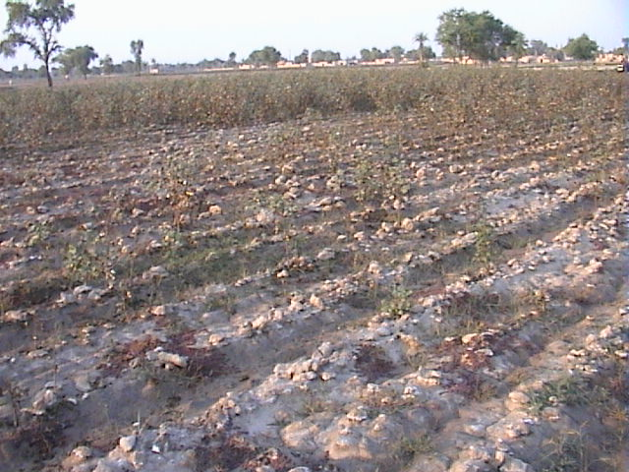
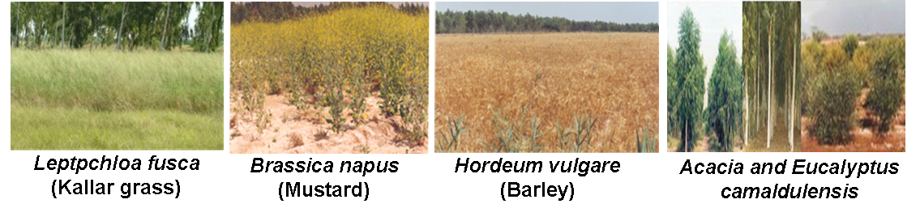
Country impact
Biosaline Agriculture
Technology development, demonstration and delivery in Pakistan
Soil salinity is a major threat to crop production in arid and semi-arid areas worldwide. In Pakistan alone, salt affected soils occur on more than 6 million heaters and over 70% of the ground-water wells in saline areas are pumping out brackish water. As a result, the areas are now subjected to serve degradation and desertification.
Numerous efforts have been made for profitable use of the saline areas and water resources in Pakistan. “Biosaline Agriculture Technology” (BAT) have been developed, demonstrated on a larger area and delivered to the end-users (= farmers). This is a low input technology and is employed for developing sustainable farming systems involving agro forestry and live stock
Objectives of Biosaline Agriculture Technology
The integrated use of genetic resources (Plants, animals, fish, and microorganisms); and improved agricultural practices
Field scale demonstration of Biosaline Agriculture for sustainable utilization of saline wasteland and saline groundwater.
Field adaptability of germplasm and large scale cultivation of selected salt tolerant species of economic value.
Salinity impact limits the vegetation cover
Value addition to the biomass produced on saline land through animal husbandry and agro-based industrial processing.
Development of Biosaline Agriculture Technology and its dissemination to end-users through demonstration and Training
Biosaline Research Initiative
Nuclear Institute for Agriculture and Biology (NIAB) played an effective role to learn to live with salinity and make profitable use of saline land and water resources. Initially screening for salt tolerance species were carried out and the scientists identified one salt tolerant variety of cotton (NIAB-999) and one salt tolerant variety of wheat (Sarsabz) for salt-affected areas. Two salt tolerant mutants, one each of mungbean & cowpea were developed and an early maturing cowpea mutant line was also identified that can tolerate salinity up to EC = 10 dS m⁻¹.
Salt Tolerant Plants
To demonstrate the feasibility of Biosaline Agriculture Technology in areas facing salinity problem, the first Biosaline Research Station (BSRS-I) of NIAB was established on 150 acres of highly salt-affected land at Rakh Dera Chal near Lahore and field scale activities were continued for about 25 years on different aspects of productive use of saline land and brackish groundwater.

Slide 2
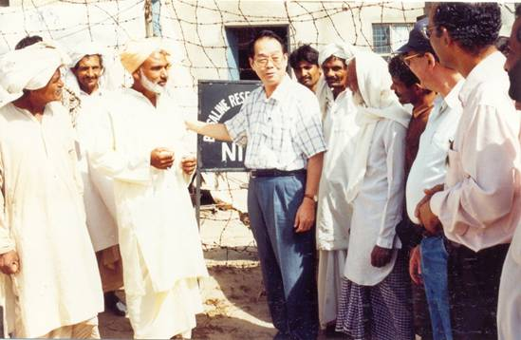
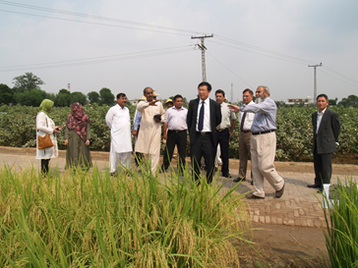
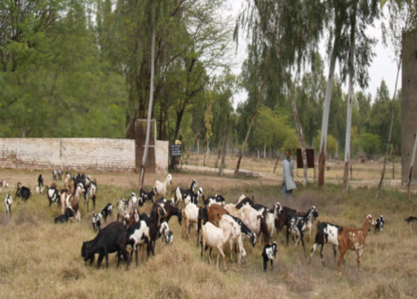
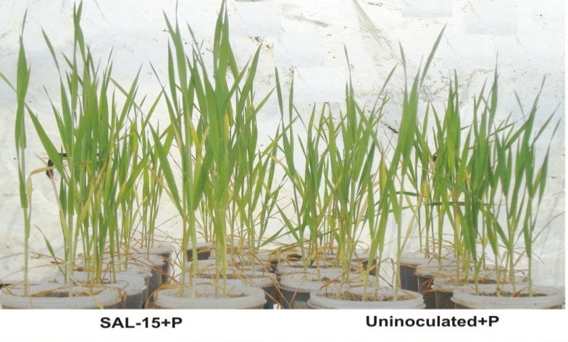
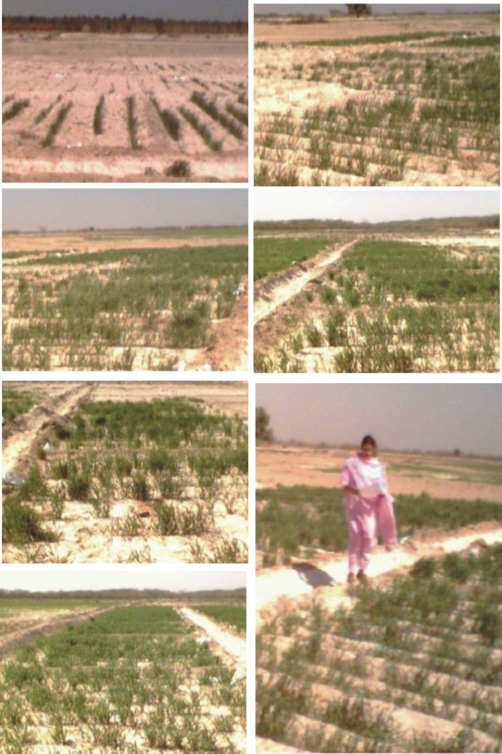
Using nuclear and other advanced techniques, R&D work and demonstration of Biosaline Agriculture Technology at BSRS-II, Pakka Anna has earned several salinity related assignments for research and technology transfer through IAEA, CSIRO-ACIAR, PARC and many other sponsoring agencies. In addition to Pakistan, Other countries benefiting from the technology transfer include Egypt, Iran, Iraq, Jordan, Morocco, Syria, Tunisia and UAE through IAEA Project INT/5144.
Value addition to biomass
IAEA Scientist meets the Farmers
A number of non-conventional forages (shrubs, trees and gasses) have been evaluated for their nutritive value.
Among the several tested species, Acacia ampliceps, Acacia nilotica, Sesbania aculeata, Leptochloa fusca, Prosopis juliflora, and Para grass contain substantial crude protein content (8-18 %), with 58-71% digestibility and are suitable for supporting livestock production. This biomass is being used successfully as forage for goat rearing.
Saline Agriculture Technology Islands’ are now emerging out exponentially in Pakistan as well as in the aforesaid countries. Pakistan Atomic Energy Commission (PAEC) has completed Biosaline Agro forestry (BIOSAFOR) Project for the remediation of saline wastelands and ‘Saline Agriculture Farmers Participatory Development Project’ (SAFPDP) to rehabilitate 10,000 ha of salt-affected lands in Pakistan. This project was operational at five sites in four provinces of the country.
Director NAFA FAO/IAEA
visiting NIAB fields
Salt Tolerant PGPRs Improve Wheat Yield in Saline Areas
Series of field experiments on wheat have been conducted at BSRS, Pakka Anna using salt tolerant Plant Growth Promoting Rhizobacteria (PGPR). These microorganisms improve plant growth employing a variety of growth promoting mechanisms including nutrient up-take, root growth, proliferation and biocontrol activities.
Salinity significantly reduced wheat yield up to 60% in both pot and field experiments. However, salt tolerant PGPR strain (SAL-15) inoculation enhanced 37% yield by alleviating the toxic effects of salinity under salt stress, 63% in the presence of inorganic tri-calcium phosphate
Goat rearing on saline lands
The selected P-solubilizing halotolernat bacteria significantly improved plant growth in the presence of inorganic phosphate on saline area. These PGPRs were found better in salt-tolerance and plant beneficial traits (i.e., IAA, P-solubilization, Zn-mobilization, ACC-deaminase production). Aeromonas spp. are dominant halo-tolerant species in BSRS-II
Biofertilizer having salt tolerant PGPR are effective for improving crop yield under saline conditions
Effect of Halo-tolerant-PGPRs on wheat growth under saline conditions at Pakka Anna
Effect of Halo-tolerant-PGPRs on wheat growth in the presence of inorganic phosphate

