Slide 1





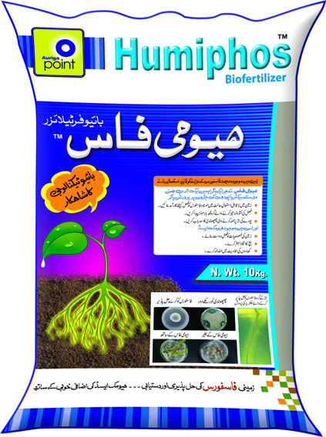
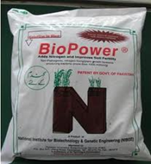
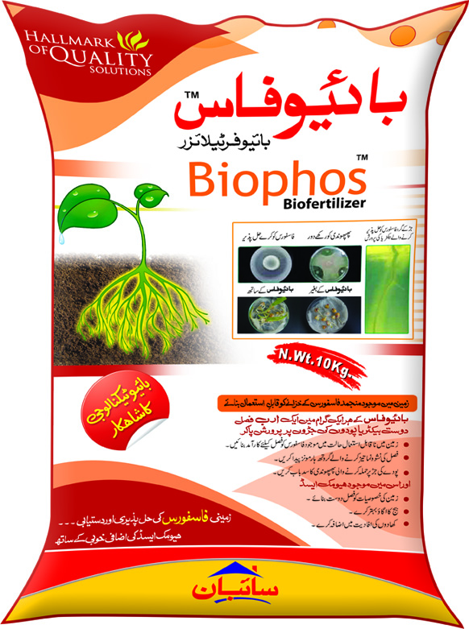
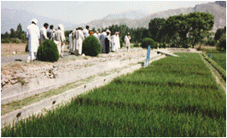
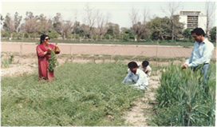
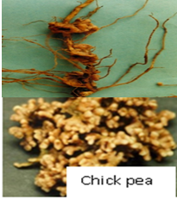
Country impact
Biofertilizer Technology in Pakistan
Lab to Field: A success story of Biofertilizer Technology for crop nutrients in Pakistan
Bio-fertilizers are suite of Plant Growth Promoting Rhizobacteria (PGPR) that enhance plant growth directly by providing mineral nutrients, mostly nitrogen (N), phosphorus (P), zinc (Zn), and other macro- and micronutrients to plants. They also produce phyto hormones.These microbes act as biocontrol agents; promote growth indirectly by suppressing the deleterious effect of phyto-pathogens.
“Nitragan” Rhizobia in 1985 in USA
Azotobacter “Azotogen” in 1937 in Russia
Extensive research since 1975
Azospirillum lipoferum inoculum “Azogreen” for maize inoculants in France 1994
Pakistan
Bej ka tika, 1965, AARI
Bio power,1996, NIBGE, PAEC
Biozote, 1998, NARC
Rice Biofert, UAF
Humiphos, Biophos 2010, CIIT
Nitrogen fixation in Legumes 1978
Nitrogen fixation in Cereals 1979
Inoculum Production 1986
Azolla 1992
Growth Hormones 1994
Biopower launching 1996
P-solubilization 1998
Bacteriocin Production 2001
Zn mobilization 2003
Biopesticides 2003
Humiphos/Biophos launching 2010
Time travel with Microbes
Ready to use Biofertilizer
History of Biofertilizers
Achievements of scientists of PAEC & CIIT
From the very beginning (1980s), IAEA through FAO/IAEA/Joint Division, Coordinated Research projects (CRPs) and Technical Cooperation (TC/RC projects) department regularly and consistently complemented these efforts of scientists of Pakistan Atomic Energy Commission. At earlier stages the laboratory/ greenhouse studies were replicated in the micro field trials which were later extended to large field areas/ demonstration plots using different crops (cereals, cotton & legumes) grown on different soil types and agro-ecological conditions (irrigated, rain fed, saline affected soil etc.) to document the beneficial effects of these products.
.
The use of N-15 stable isotopic dilution technique played a key role in the selection of efficient microbes and demonstrates their task in the field experiments in various cropping system in diverse ecological zones .These microbes have some host specificity; these PGPR fixed atmospheric nitrogen (% Ndfa) ranging from 11-59% on two rice varieties Bas-385 and Supper Basmati. At earlier stages the laboratory/ greenhouse studies were replicated in the micro field trials which were later extended to large field areas using different crops (cereals, cotton & legumes) grown on different soil types and agro-ecological conditions (irrigated, rain fed, saline affected soil etc.) to document the beneficial effects of these products
Farmers visiting rice fields demonstration plots
N-15 based chickpea field experiment under FAO/IAEA CRP project . Healthy nodules efficient in fixing atmospheric nitrogen

Slide 2
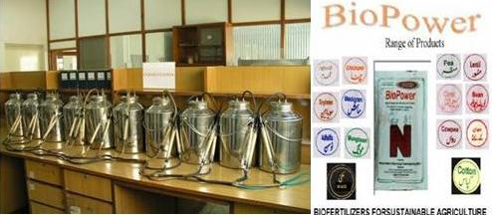
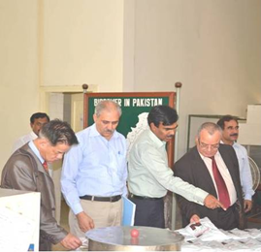
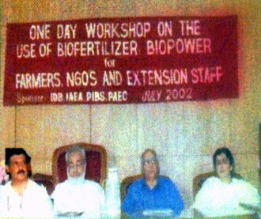
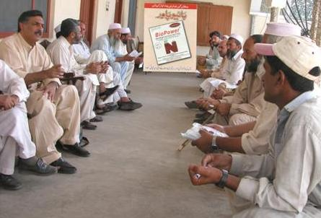
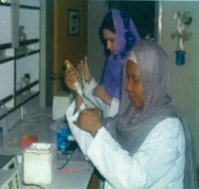
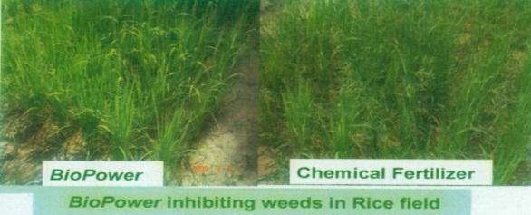
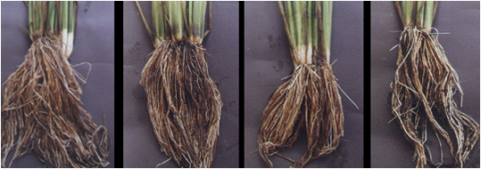
Production / Outreach
A pilot Biofertilizer assembly plant was also set up at National Institute for Biotechnology and Genetic Engineering (NIBGE) to deliver the technology for the benefits of end-users (farmers) under the name of BioPower (http//:www.nibge.org).
Public sector leading research and academic
organizations like COMSATS Institute of Information
Technology (CIIT), National Agriculture Research
Center (NARC), Ayub Agriculture Research Institute
(AAR), University of Agriculture Faisalabad (UAF) in
addition to Pakistan Atomic Energy Commission (PAEC) contributed in establishing and expanding this technology which was finally taken up by the private sector. The impact of these Biofertilizers drew the attention of entrepreneur and through public-private partnership (Humiphos & Biophos: phosphatic biofertilizers), this venture had acquired an industrial status..
IAEA delegation led by Director TCAP and Section head, SWMCN of NA department visiting pilot scale fermentation assembly of Biofertilizer production unit at NIBGE, Faisalabad, Pakistan
Farmers attending awareness workshop on Bio-fertilizer
The Government of Pakistan recently approved quality standards for the approval and monitoring of the commercial Bio-fertilizers.
Six commercial Biofertilizers products are available in the market and gaining popularity among the farmers
IAEA sponsored fellow from Tanzania
learning lab techniques
Dose and Application
One bag per acre weighing about 1 KG is required for small seed crops and two bags per acre for large seed crops. Mode of application is simple.
Seedling root dip for rice, sugarcane and onion
Seed treatment for grain crops
Dose / Application
One bag (BioPower) per acre weighing about 1 kg is required for small seed crops and two bags per acre for large seed crops.
Mode of application is simple.
Seedling root dip for rice, sugarcane and onion
Seed treatment for grain crops.
½ NP+BP ½ NP+BP+Zn NP+Zn NP
Impact
Application of Biofertilizers promises the saving of half nitrogen and phosphorus fertilizers
20-30% yield increase in a range of crops.
Improve soil structure/ fertility for sustainable agriculture
Reduce soil born diseases
Reduce environmental hazards of chemical fertilizer and pesticides
Healthy roots development & better nutrient uptake due to PGPR through Biofertilizer
Biofertilizer is a premium quality supplemental inoculant for all crops, which enhances nutritional availability and produces superior yields. This rich blend of microbes works to revitalize the soil and feed the plant so the crop thrives
Complex delivery chain of “Labs to Land” for R&D project appears successful.

