Slide 1
International Atomic Energy Agency Learning programme: Radon gas
Module 4:
Developing and Implementing a Representative Indoor Radon Survey

Slide 2
Content
Scope of this module
Representative radon survey aims
Population-based surveys
Geographically-based surveys
Summary of learning points
Additional reading

Slide 3
Scope of this Module
This module covers large scale (national or regional) surveys to evaluate radon in homes only, but many of the same considerations also apply to radon surveys in buildings with other uses.
Similarly, this module does not specifically address surveys of radon in workplaces or in other buildings with high occupancy factors for members of the public (such as kindergartens, schools and hospitals). Such buildings are fewer in number (compared to homes) and it is likely that every such building will be individually assessed rather than sampled in a survey.
This module focuses on surveys based on direct indoor radon measurement rather than soil gas surveys or other predictive methods.
Notes:
This module focuses on radon surveys in homes only.
From the perspective of geographical distribution of radon, homes, are more numerous than other buildings, and therefore provide a good population for survey and the spatial distribution data arising are also generally relevant for other building types.
From a population exposure perspective, survey of homes is likely to provide exposure information relevant to the majority of the population
High-occupancy buildings should be separately assessed as they can be representative for significant portion of the population
Due to their lower number such buildings might be considered for individual assessment rather than a sampling survey approach.
Assessment of large buildings will require a different measurement protocol.
This module focuses on surveys based on direct indoor radon measurement rather than soil gas surveys or other predictive methods.

Slide 4
General Safety Requirements (GSR) Part 3
GSR Part 3 does not specifically advise that a national radon survey needs to be undertaken, but rather that ‘representative radon surveys’ are necessary.
Representative radon surveys can be national or regional
It is recommended that the National Authority establish a working group to consider the scale and nature of a representative survey
Notes:
The Basic Safety Standards (BSS) requires that national radon exposure is evaluated so that unacceptable exposures are identified and managed.
This evaluation will require knowledge of the range and average concentration of radon to which the population is exposed and the geographical distribution of radon exposure in the territory.
GSR Part 3 does not specify that these data are gathered by national survey but rather by representative surveys. In practice such representative surveys are undertaken nationwide, but in some countries a regional approach is justified on the basis of pre-existing information.
It is up to the national authority to decide how to meet these requirements.
It should be borne in mind that the annual average of radon concentration in a specific dwelling cannot be estimated in a reliable way and a measurement is necessary to obtain it. Although soil and rock is the main radon source, the distribution of indoor radon concentrations in a region or in a whole country cannot be reliably estimated on the basis of soil or geological characteristics because of the high influence of building characteristics on the entry of radon gas into the building.

Slide 5
Pre-Survey: Existing Data
Existing Radon Data
Reliability, representativeness
Geological Data
Bedrock, soil, aquifers
Climate data
Health data
Statistical data on lung cancer incidence/mortality,
Smoking prevalence
Housing styles/types
Ventilation impacts, crawl space, basements, etc.
Homes with permanent openings or on stilts
Notes:
As a first step in evaluating population radon exposure and national geographical distribution of radon, it is worthwhile considering existing data which may have been collected by universities or geological institutes.
Care must be taken in the interpretation of these data as they may not be truly representative or reliable. This will be the case especially where the data are from multiple sources that are using different methodologies.
Geological data will provide some indication of the radon prone areas in the territory but the correlation between geology and indoor radon concentration is not direct as it is influenced by soil type and construction type and other factors.
In turn, the correlation with indoor radon concentrations is not straightforward as it depends on building characteristics like construction type (with/without basement), building materials, ventilation rate, airtightness of building envelope, etc. Therefore, geology or soil gas radon cannot generally be a reliable predictor of indoor radon
Lung health data may in some instances indicate geographical areas of concern, i.e. where lung cancer is higher than expected based on national statistics. Care should be taken in interpretation due to the overwhelming influence of smoking on lung cancer incidence.
Housing styles will have a significant influence on indoor radon exposure. Structures that have little contact with the soil (e.g. on stilts or with crawl space), or which are permanently ventilated (e.g. in tropical areas) may have low levels of radon ingress, and conversely basements and poorly ventilated homes often present a greater risk.

Slide 6
Pre-Survey: Pilot Study
Small scale and manageable
Test of logistics
Test of public reaction and cooperation
Learning on unexpected issues
Opportunity to determine seasonal correction factors and background radon concentrations
Notes:
Before commencing an indoor radon survey, especially in the absence of pre-existing information, it is very valuable to undertake a pilot survey. Existing studies, perhaps undertaken by universities, that are consistent in methodology with the requirements of the national survey, may serve as a pilot.
A pilot study may be regarded as a small scale and manageable learning opportunity which will save resources in the long run.
While the primary purpose may be to decide whether a full scale survey is required, as much care and consideration should be given to the design of a pilot survey as would be given to a full survey, and a pilot survey should use the same measurement protocols and quality standards.
A pilot survey may be designed for any of a number of reasons including:
− to provide insight into the range and variability of radon values observed;
− to gather preliminary data on radon concentrations in different regions/house types etc.;
− to determine background radon concentrations;
− to determine seasonal correction factors;
− to test logistical aspects such as
• how to recruit participants;
• the participation rate to be expected in the main survey;
• the types of information to provide to participants;
• the types of information to collect from participants;
• the delivery method of radon detectors to and from the homes;
• follow-up with participants throughout the survey;
• the analysis and QA/QC of indoor radon measurements; and
• how to effectively communicate results to participants.

Slide 7
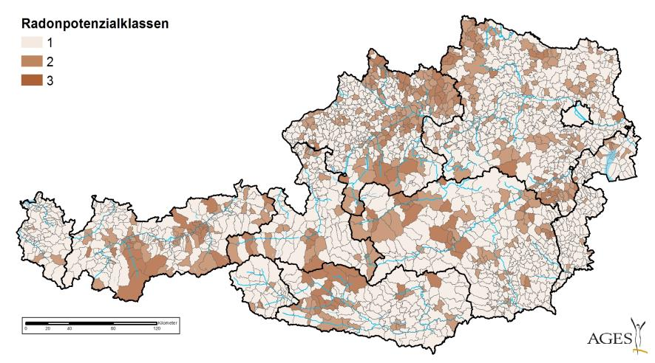
Representative radon survey – 2 general approaches
Exposure risk determined by a population-based survey
Radon prone areas determined by a geographically-based survey
Radon potential classes
A carefully designed survey can, in principle, meet the requirements and objectives of both types of surveys
Map basis: 15,035 ÖNRAP radon measurements, Austria
Notes:
There are two general approaches to a representative radon survey
Evaluation of the frequency distribution of and average of radon concentrations across the survey territory in order to determine the exposure risk of the full population of the region. This is designed as a population-based or population weighted survey, i.e. the sampling density is linked to population density and the samples are selected to represent the full population.
Evaluation of the geographical distribution of radon concentrations in order to identify radon prone areas. This is designed as a geographically-based survey, i.e. the spatial distribution of the samples is such that each area of the territory is sampled.
Both survey types require a different design and sampling strategy, but it is possible to meet the requirements of both in a single survey.

Slide 8
Population weighted (or population-based) survey
Aim:
To estimate the frequency distribution of radon values in the country and the average exposure of the population to indoor radon.
Measured homes have to be representative of the total housing stock → random selection.
Get statistical advice
Notes:
A population representative (or –weighted or –based) survey of radon concentrations in homes across the country can be obtained with several hundreds to a few thousands of sampled dwellings depending on the population and other factors.
The sampling strategy should be carefully considered and it is strongly recommended that statistical advice is sought.
The samples selected should be representative of the total housing stock – it should not favour for example particular house styles or ages, regional or rural versus urban cohorts, socioeconomic or other occupant profiles.
It can be useful to consider the structure of other relevant data when designing a survey strategy, so that the new radon data are comparable with, for example, health statistics.
It is also valuable to consider at the outset, that in order to assess the impact of the Radon Action Plan a repeat population based survey will be required. This can be taken into account in the survey design to ensure comparability of the first and subsequent datasets.

Slide 9
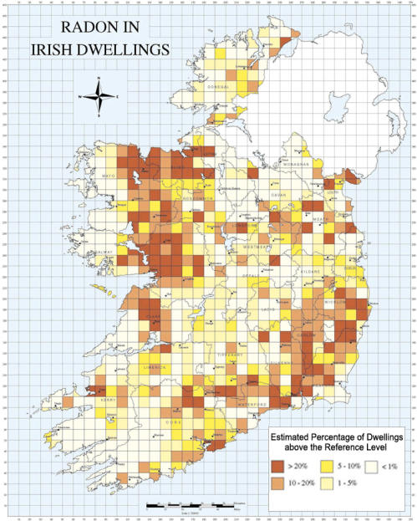
Geographically-based survey
Aim:
To identify those areas within the country where high indoor radon concentrations are more likely to be found
Measured homes must be based on a geographically-based unit area. The area can be regular (grid square) or irregular (administrative unit) or other spatial unit (geological unit).
The homes selected for the survey should be representative of those in each area.
Get statistical advice
Notes:
Surveys aimed to provide insight into the spatial distribution of radon across the territory are carried out by dividing the territory into geographical units such as a national grid or administrative units, with each unit being sampled so that each unit is adequately represented in the final data set.
The sampling strategy should be carefully considered and it is strongly recommended that statistical advice is sought.
It can be useful to consider the structure of other relevant spatial data when designing a survey strategy, so that the new radon data are comparable, with for example, geological data, health statistics or housing information.
A review has been undertaken of radon surveys and mapping strategies across Europe which gives helpful insights into the range of approaches taken and contact details of the responsible authorities - An overview of radon surveys in Europe. https://rem.jrc.ec.europa.eu/remweb/publications/EUR_RADON.pdf

Slide 10
Sampling and Sample Numbers
Simple Random Sampling
Random sample from the list of all dwellings or inhabitants
Stratified Random Sampling
Target population is partitioned into separated groups (strata). This may be appropriate where distribution of population is uneven and different strata require different sampling densities
Cluster or Multi-Stage Sampling
Within a region, a random selection of towns is performed, then; within the selected towns, a random selection of homes is performed
Numbers of Samples
Typically <1% of the housing stock
Depends on size of population or territory to be surveyed
Depends on variability expected and variability accepted
Notes:
There are three basic approaches to sample selection and again it is emphasised that expert statistical input is desirable.
Simple Random Sampling: A simple random sampling is in principle the easiest way to obtain a representative sample. Simple random sampling is the basic sampling technique where we select a group of subjects (a sample) for study from a larger group (a population). Each individual is chosen entirely by chance and each member of the population has an equal chance of being included in the sample.
Samples can be drawn from a list or population of homes (e.g. addresses) or from lists of occupants of the homes (e.g. based on social security numbers, electoral lists). A random sampling strategy can have inherent bias if the source population is not representative of the total population.
Stratified Random Sampling: Stratified sampling is a probability sampling technique wherein the entire population is divided into different subgroups or strata, then the final subjects are randomly and proportionally selected from the different strata. For example, the national or regional population of dwellings is divided into separate groups or strata (e.g. the administrative regions in the country) and each administrative region of the country is sampled in a simple random manner with sample numbers in each administrative region reflecting the population size in that region in order to a achieve a population weighted dataset.
Cluster or Multi-Stage Sampling: Cluster sampling refers to sampling plans where the sampling is carried out in stages using smaller and smaller sampling units at each stage. Cluster sampling is similar to Stratified Sampling but they are substantially different. In stratified sampling, a random sample is drawn from all the strata, whereas in cluster sampling only the selected clusters are studied, either in single- or multi-stage.
Cluster sampling can be beneficial when a complete list of all members of the population does not exist or it is inappropriate or impractical to treat the entire population as a single group.
An example of multi-stage sampling can also be used (e.g. random selection of towns, followed by random selection of dwellings within the towns).
While Cluster Sampling can be simpler and more cost effective, it is not as accurate as Simple Random Sampling and can be difficult to repeat which is important for future assessment of impact of the Radon Action Plan.
Sample size: The required sample size depends on several factors, such as the precision required, the number of strata, the country population, the size of the country. The sample size used for nationwide surveys ranges typically from a few thousands to several thousands of dwellings and generally sample less than 1% of the housing stock. Population based surveys tend to be smaller than geographically based surveys but that depends on the national characteristics.

Slide 11
Randomness, Completeness, and Bias
Be sure that the source list or database is representative and complete
Be wary of “volunteer” participants
Be wary of “surrogate lists”
For example, landline phone number lists – these may not be random as more homes may not have a landline
Failure to consider such factors will lead to bias
Notes:
In order to provide a reliable dataset that can be considered representative of the population exposure across the territory, it is important to design a survey specifically for the purpose in question. While existing datasets or datasets gathered for other purposes can provide some basic information there is a risk of bias in these non-specific surveys. For example studies carried out in radon prone areas will overestimate the overall population exposure, while surveys based on volunteer measurements may select buildings in high radon areas due to concerned occupants being more likely to volunteer.
Dwellings and householders. Existing house based databases such as postal codes or individual based databases such as electoral lists can be used as a source of sampling point details.
Randomness and completeness. If the source lists or databases are complete for the entire territory then a random selection of homes or individuals from these lists should provide a complete and representative sample of the entire population.
For practical reasons a surrogate of a complete list of dwellings (or inhabitants) could be used (e.g. the list of telephone numbers, or the list of dwellings of workers of a particular company which is distributed all over the country, or social security numbers). In such cases a careful evaluation of such surrogates is needed because if the list is not complete for the entire population any subsequent sampling can result in biases. The sample size is also important for representativeness: the higher the sample numbers the lower the chance that the selected sample could contain a non-representative selection of dwellings.

Slide 12
Detectors, Measurement, Placement
Detector Type
Measurement Protocols
Transport and Packaging
Detector Placement
Measurement Period
Quality Assurance and Quality Control
Data Management
Reporting and
Advice to the Public
Notes:
The design of the measurement protocol is an action that should be addressed in the National Radon Action Plan as it will form the basis of the national survey, but will also serve as the approved standard for on-going radon measurement services by national or private laboratory services.
The protocol should address: detector type; transport and packaging to and from the measurement site; detector placement in the home and within the chosen room(s) in the home; duration of test period; laboratory methods and quality assurance; data management; reporting and advice. This will be addressed in more detail in Module 5.
The National Authority will decide how in practice the survey will be implemented (e.g. whether the householder will be responsible for detector placement and return to the laboratory using the postal service, or whether survey staff will directly place the detectors and collect them at the end of the survey or some other approach). Such decisions will inform the standard measurement protocol and will also dictate the required implementation arrangements. In a general sense there is no one correct approach and many of these considerations may be clarified by undertaking a pilot survey prior to the main survey.

Slide 13
Questionnaire for Survey
Opportunity to add value
House age and construction type
Ventilation type
Basement or foundation details
Heating method
Daily occupation pattern
Smoking habits
Water source
Permission for data use
Permission on follow up research
Notes:
Since considerable resources will have been applied to selecting and engaging with individual householders, it is worthwhile to maximise the information gained by implementing a short questionnaire-based survey.
This questionnaire can obtain information for example on dwelling characteristics and other parameters (such as living habits) that could explain some of the variability of the observed radon concentration levels and point to features of “radon prone homes” (for example if the water source is a natural well this may explain higher than expected radon concentrations compared to homes on a municipal water supply). This questionnaire can be more or less detailed and comprehensive, depending on who fills it, i.e., trained personnel interviewing householders or householders themselves.
The questionnaire may be set up on-line or be paper-based. This questionnaire is a useful opportunity to obtain from the householder their permission for publication and re-use of data relating to their home for research purposes, and for contact in the event of follow-up surveys.

Slide 14
Communication and Engagement
Pre-survey engagement
Letter/info pack, phone call, local media
Survey engagement
Detector pack or direct contact
During survey
Phone call, SMS (text message)
Post survey
Report and advice
Further research/follow-up
Notes:
A good approach to engaging and communicating with householders prior to, during and following the survey will ensure greater cooperation, fewer detector losses, public trust and on-going positive engagement with the national authority.
It is advisable to maintain contact with survey participants throughout the survey as this will minimise drop-outs.
Consideration might be given to the following options:
Media advertising of the programme in order to prime intended recipients and to underpin the legitimacy and purpose of the survey.
Invitation to participate posted to household, including information, questionnaire and pre-paid return envelope. This invitation will ask willing participants to return a consent form and questionnaire.
Detector pack and information posted to willing participants or alternatively, survey staff go to home of willing participants to place detectors and explain any outstanding details. In the latter case the survey staff can assist with the questionnaire.
To avoid survey staff calling repeatedly to selected homes, time of day will be important where the householder is at work, and an appointment may be scheduled
SMS (text) contact can be made with participants during the measurement period to remind them of the purpose of the survey and on the correct management of the detectors
SMS reminder can be issued to participants inviting them to return detectors by post at the end of the survey. Freepost envelopes can be provided particularly as the detector may need a special envelope to protect it in the postal system.
Survey Staff can visit the homes to collect detectors.
Direct phone call or visit to participants to return any overdue detectors
Assurance should be given of confidentiality on the data generated about individual homes
Request consent (opt-out tick-box) of the householder to use their data for research purposes and for future follow up contact regarding radon matters.
A radon report on the individual home should be provided to the householder in the normal way and where concentrations in excess of the reference level are found, there should be appropriate follow-up and advice.

Slide 15
Data validation and analysis
Representativeness
Check that bias has not entered the data (for example, due to an unknown failure of postal service in one area)
Log-normality test
Check that the frequency distribution of radon concentration is log-normal
Sampling scheme
simple sampling
stratified sampling
Notes:
The analysis of the measurement results has to take into account the sampling scheme in order to obtain representative estimates of the parameters of the indoor radon concentration distribution.
Where a simple random sampling approach is taken, this is the most straightforward with all the results being analysed as a single dataset with no weighting. In this case, for example, the representative value of the average radon concentration is just the sum of average radon concentration for each sampled dwelling divided for the number of sampled dwellings.
In case of more complex sampling schemes (e.g. a stratified sampling), the parameters have to be calculated separately for each stratum and combined and weighted to take into account the strata size.
Checks for log-normality -
The frequency distribution of radon concentration tends to have a log-normal shape, i.e. logarithm of measured radon concentrations tends to be normally distributed. The best way is to check for log normality is to plot measured values on a normal probability plot, where perfectly log-normally distributed data would appear as a straight line. Normal probability plots can generally be produced by statistical software packages. Typically, radon concentration data deviate from a log normal plot at the upper end of their values. This will require further analysis before proceeding to interpret the survey findings.

Slide 16
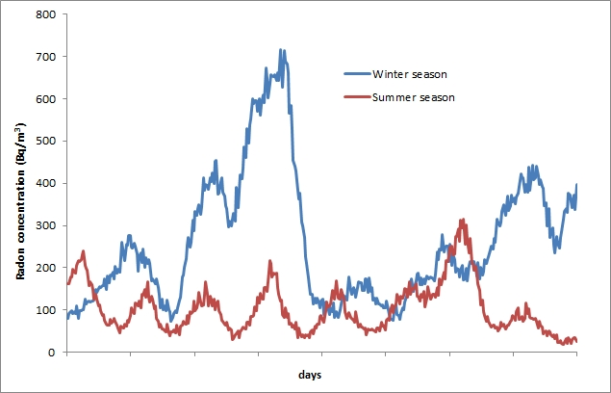
Data correction
Background Radon Concentrations
Survey
Adjustment to log normal plot
Seasonal Correction Factor
12 month measurements
Fixed season measurements
Seasonal correction
Seasonal variation of indoor radon concentration.
Source: SURO: National Radiation Protection Institute of Czech Republic
Notes:
The frequency distribution of radon concentration tends to have a log-normal shape, i.e. logarithm of measured radon concentrations tends to be normally distributed.
Significant deviations from log-normal distribution often occur on the high value tail of the frequency distribution of measured radon concentrations.
Background correction
These deviations are probably (at least in part) due to the additional influence of external (outdoor) radon concentrations on the indoor value or radon due to other sources.
The value of this additional radon can be estimated by undertaking a representative outdoor radon concentration values. This may be something that will be addressed in the pre-survey pilot stage or as a separate research project.
The value can be numerically estimated by subtracting different constant values from each measured radon concentration, until the frequency distribution corresponds more closely to a log-normal distribution.
Seasonal Correction (next slide)

Slide 17
Data correction (continued)
Background Radon Concentrations
Survey
Adjustment to log normal plot
Seasonal Correction Factor
12 month measurements
Fixed season measurements
Seasonal correction
Seasonal variation of indoor radon concentration.
Source: SURO: National Radiation Protection Institute of Czech Republic
Notes:
Seasonal Correction
Indoor radon concentrations can vary significantly daily (rising at night when house is usually closed and occupants inactive, falling during the day as ventilation increases and occupants go in and out) and seasonally (rising in the cold/heating season when ventilation tends to be lower and the effect of heating is greater drawing soil gas into the home and falling during warmer weather when there is more ventilation and the pressure differential between the outside and inside environment is less) .
Measurements taken over a number of days will eliminate any estimation error due to daily fluctuations.
Estimation due to seasonal variations is avoided either through taking measurements over 12 months or applying a seasonal correction factor to shorter term measurements.
The advantage of a 12-month measurement is that it requires no correction, but it prolongs the survey period and risks greater losses (people move house, lose detectors during home renovations, etc.)
Shorter measurements (3-month for example) can be taken at the same time in every home e.g., Jan-March, and thereby eliminating variation between samples. In this case a “heating season” (or winter/cold season) measurement is recommended even though this will provide an overestimate of the annual average.
This can be logistically difficult and still requires seasonal correction to get a true value of the annual average to compare with a reference level (which should be based on an annual average).
For any given dwelling, the annual average radon concentration estimated with a three month measurement and a seasonal correction factor has a higher uncertainty compared with results obtained with a 12-month measurement, because seasonal variation can be different for different dwellings and the correction factors are based on average seasonal variations.
Year on year variability
With 12-month measurements the frequency distribution of measured values can have a higher spread or range than the true values, due to year on year variations in radon concentrations. Corrections can be made based on studies of year on year variation. The variance of the year-to-year variations (in the log scale) should be estimated and subtracted from the variance (in the log scale) of the observed radon distribution. This will reduce the Geometric Standard Deviation of the data but not the Geometric Mean value.
There are many scholarly articles describing the calculation of seasonal correction factors – see reading list for examples.

Slide 18
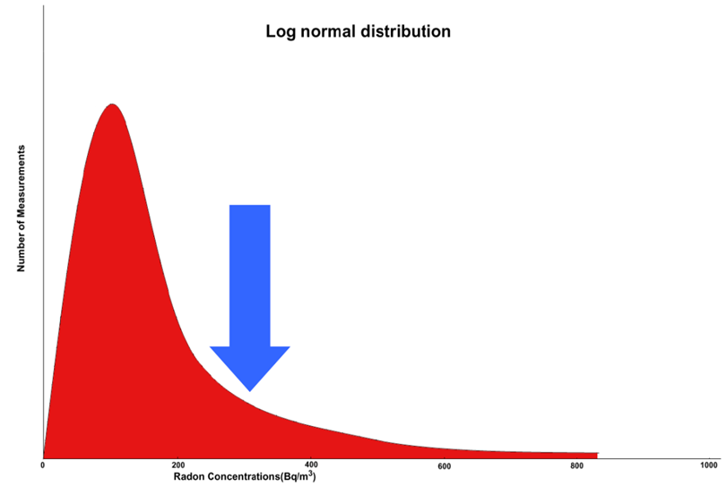
Data analysis
Arithmetic mean and standard deviation
Geometric mean (GM) and geometric standard deviation (GSD)
Percentage of homes over reference level
Knowing GM and GSD, the percentage of dwellings exceeding any reference level (RL) can be estimated by using statistical tables of the area under the standardized normal curve
RL
Notes:
The data analysis undertaken has to be appropriate to the sampling strategy. The easiest approach is simple random sampling, where all the results can be analysed together with no weighting, because the probability to be included in the sample is the same for all the sampled dwellings and there is a single stratum.
As noted previously: In this case, the arithmetic mean represents the average radon concentration. In case of more complex sampling schemes, e.g. for a stratified sampling regime, the parameters have to be calculated separately for each stratum and combined in a proper way to take into account the strata size.
Because the distribution of radon in most surveys follows a log normal distribution, many countries report their summary data using the geometric mean (GM) and geometric standard deviation (GSD). However, to maintain comparability with other countries that do not use GM and GSD, it is useful to present summary data using both the GM and arithmetic mean (AM) and their respective measures of standard deviation (i.e. GSD, SD)
Knowing GM and GSD, the percentage of dwellings exceeding any reference level (RL) can be easily estimated by using statistical tables of the area under the standardized normal curve.

Slide 19
Mapping the survey data
Geographical-based survey
Identify radon prone areas
Define “radon prone”
Benefits of maps
Prioritising action
Raising awareness
Risks of maps
Boundaries incorrectly interpreted as “safe/unsafe”
Incorrectly substituted for radon testing
Rn
Radon risk map = map of radon prone areas = a tool for planning;
it is NOT a predictor of indoor radon concentration
Notes:
Data collected on a geographical basis can identify radon-prone areas and may be represented on a radon potential map.
The definition of radon-prone varies and can be decided by the national authority; for example:
International Commission on Radiological Protection (ICRP) 65 – radon-prone areas could be defined as those where more than a certain percentage (e.g. 1%) of dwellings have a concentration of ²²²Rn exceeding ten times the national average value.
ICRP 103 - an area in which the concentration of radon in buildings is likely to be higher than the national average.
ICRP 115/126 - a geographic area or an administrative region defined on the basis of surveys indicating a significantly higher level of radon concentration than in other parts of the country.
Ireland - High Radon Area (HRA) is one where 10% or more of homes are predicted to have radon concentrations above the Reference Level of 200 Bq/m³ (Radon Gas in Ireland - Joint Position Statement by the Radiological Protection Institute of Ireland and the Health Service Executive, 2010)
Benefits: The visual information that a map provides can be a powerful tool in raising awareness of the public and advocating for regulatory change with policy makers. Therefore, it is seen as a useful tool in implementing a national radon policy (for example, a map can be used to focus resources on finding high radon houses in radon prone areas, or as a basis for applying construction standards for radon prevention in new homes in high risk areas).
Risks: However, maps also suffer from misinterpretation; in cases where maps are presented as probabilistic indicators of risk (for example, high, medium and low), it is difficult to explain the boundaries between high and low risk, and difficult to convince the public and public representatives that even in low risk areas high values of radon can occur.
Also, the potential exists to refine the map by combining with other data such as geological data, to develop radon predictive models. Such modelling may generate better maps in the future which, on a local scale, will not exactly match the survey based map. It can be difficult to explain these differences to public satisfaction, particularly where there are policies linked to the maps (e.g., construction standards).

Slide 20
Soil gas measurements
Direct measurements of radon in soil gas
Identification of radon-prone areas
May be correlated with indoor radon concentrations
Radon modelling
Combining different parameters – indoor radon concentrations, soil gas radon concentrations, geological parameters, and aerial radioactivity measurements – can result in a higher definition radon map than might be achieved by survey of indoor radon alone.
Notes:
Direct measurements of radon in soil gas have been used in some countries to identify radon prone areas.
Provided soil gas measurements have been correlated with indoor radon concentrations, these measurements can then give an indication of indoor radon risk. For example, in Germany, the radon map is based on radon concentrations in soil gas.
Using data on the various parameters that are known to influence indoor radon, predictive models can be developed to provide better resolution maps than might be possible (within limited resources) by survey of indoor measurements. Such an approach would need to model radon emanation from soil and ingress to buildings of different construction types if it were to predict indoor radon concentrations.
The United States of America developed its radon map based on a combination of indoor measurements, geological characteristics, aerial radioactivity, soil permeability and foundation type (Protocols for Radon and Radon Decay Product Measurements in Homes. https://www.epa.gov/radon/protocols-radon-and-radon-decay-product-measurements-homes)

Slide 21
Data Management
National Radon Action Plan - long term
Survey updates
On-going data collection
Data management
National authority
Private measurement services
National database
Notes:
The National Radon Action Plan (NRAP) is a long term project and much data will be collected and analysed during its life. It is prudent to plan for and construct a robust database to store data associated with the action plan and particularly the survey(s).
As a measure of the radon programme’s effectiveness, there will be a need to re-survey and compare radon concentrations over time.
As the NRAP progresses and awareness of radon grows, homeowners will likely voluntarily seek radon tests. Data arising from these measurements will provide useful research data and should be housed and managed.
Where there is a single national laboratory, data collection and central data management will be relatively simple to arrange. Where there are multiple radon measurement services operating in a country, the national authority might consider making arrangements to collate available data. An approach might be to require measurement services to submit data in order to maintain “approved service” status.
Additional parameters which might be collated in a national database are:
Radon concentration before and after remediation (mitigation),
Rate of remediation,
Building characteristics,
Type of remediation measures,
Installation costs of remediation measures,
Annual operation and maintenance costs of remediation measures.

Slide 22
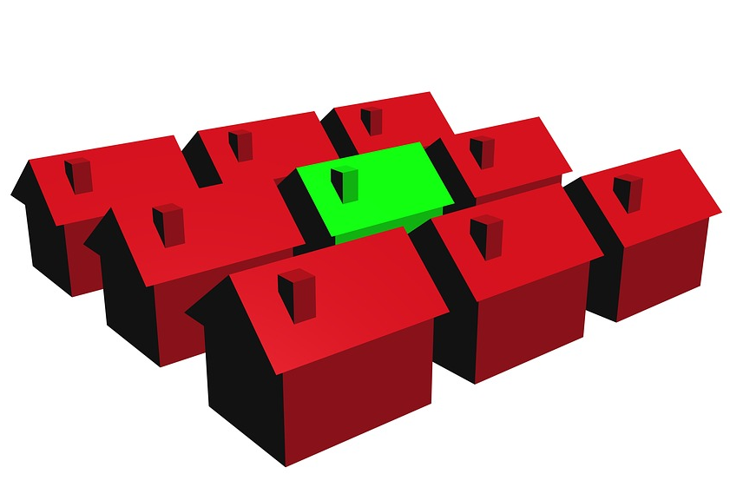
Metrics and Follow-up
Metrics – lagging indicators
Population-based national average indoor radon concentration
Lung cancer risk due to radon
Follow-up interval dictated by rates of radon remediation and rates of new home construction with radon preventative measures
Notes:
As discussed in Module 3, the National Radon Action Plan should include periodic monitoring and reviewing of performance.
Metrics provide tools to measure and monitor progress over time. The metrics must be measurable, meaningful, have longevity and have an established baseline.
The representative radon survey findings will represent one baseline for the National Radon Action Plan.
The population based survey findings are particularly relevant as it is this parameter that is likely to be reduced once remediation and prevention methods start to take effect.
This metric is considered “lagging” (i.e., it will not demonstrate change over a short time frame).
Another related lagging parameter is the lung cancer rate due to radon. Any change in this metric over time will be confounded by changes in smoking rates over time.
The frequency of repeat surveying (or follow-up) will be dictated by the pace of progress on radon actions.

Slide 23
Summary of Learning Points (1)
GSR Part 3 requires evaluation of radon exposure, if necessary, by undertaking representative radon surveys
The nature of the representative survey is at the discretion of the national authority and can be informed by review of existing data and/or performance of a pilot study
Two survey types are described but both can be combined in a single survey: Population-based, to estimate public exposure to radon, and Geographically-based, to identify radon prone areas
Radon maps can be enhanced with the use of geological and soil gas survey data
Sampling methods are tailored to the survey requirements and the advice of a statistician is recommended

Slide 24
Summary of Learning Points (2)
Sampled households should, in all cases, be representative of the whole population
A questionnaire can be included in the survey strategy to gather relevant additional information
Effective communication with the survey participants will reduce data losses and lead to more successful outcomes
Mapping of radon survey data is a valuable tool for policy and planning but maps risk misinterpretation
A data management system is recommended
Follow-up survey(s) will be required in due course to assess the progress of the National Radon Action Plan

Slide 25
Further Reading
International Atomic Energy Agency/AQ/33: National and Regional Surveys of Radon Concentration in Dwellings: Review of Methodology and Measurement Techniques
IAEA (2015). Protection of the Public against Exposure Indoors due to Radon and Other Natural Sources of Radiation: Specific Safety Guide. No. SSG-32, Vienna.
World Health Organization (2009). Handbook on Radon: A Public Health Perspective, Geneva.
United Nations Scientific Committee on the Effects of Atomic Radiation (UNSCEAR), 2006 Report, Volume II, Annex E: Sources to effects assessment for radon in homes and workplaces. United Nations ed., New York (2009) and Annex B: Exposures from natural radiation sources. United Nations ed., New York (2000)

Slide 26
Further Reading (2)
Dubois, G., (2005). An overview of radon surveys in Europe, EUR 21892 EN, EC 1–168.
WHO (2007). International Radon Project: Survey on radon guidelines, programmes and activities, WHO/HSE/RAD/07.01.
Burke, O., Long, S., Murphy, P., Organo, C., Fenton, D. and Colgan, P.A. (2010). Estimation of seasonal correction factors through Fourier decomposition analysis – a new model for indoor radon levels in Irish homes. Journal of Radiological Protection. 30 433-443.
An overview of radon surveys in Europe: (https://rem.jrc.ec.europa.eu/remweb/publications/EUR_RADON.pdf)
USEPA - Protocols for Radon and Radon Decay Product Measurements in Homes

Slide 27
July 2018

