Slide 1
International Atomic Energy Agency
Learning programme on:
Radon gas
Module 1:
What is radon?
Radon and its health effects

Slide 2
Content
What is radon?
Why is it of concern?
Global levels of radon
The impact of radon on health
The combined effect with smoking
How radon enters homes and workplaces
Variations and fluctuations in radon levels
Summary learning points

Slide 3
What is radon?
Radon is a radioactive gas
It is natural and is everywhere
It is continually produced by the decay of uranium, which occurs naturally in soils and rocks
Once produced, radon escapes into the open air unless it enters a building or enclosed space
Radon
Radium
Uranium
Notes:
Radon is a radioactive gas
Radon is a noble gas
It has no colour, taste or smell. It can only be detected by using radon detectors (e.g. measurement devices).
It is produced naturally and continuously in the rocks and soils that make up our environment.
It originates from the radioactive decay of uranium which is present in all rocks and soils.
Radon (²²²Rn) is formed from radium (²²⁶Ra), which is a decay product from uranium (²³⁸U).
Outdoors, radon is rarely a problem as it quickly dilutes to very low concentrations.
Indoors, and for example in caves and mines, radon can build up to very high levels.

Slide 4
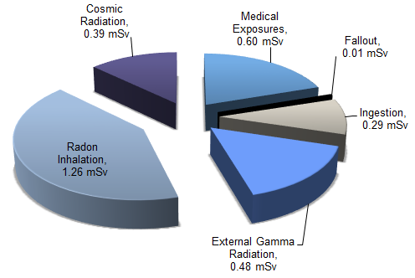
Why is radon of concern?
Radon is a known cause of lung cancer (Class 1 carcinogen*)
Radon is responsible for almost one half of total ionising radiation dose received by the public each year.
Radon exposure can be controlled so as to reduce its health effects
Radon health risk is 25 times greater for people who smoke
UNSCEAR, 2008 REPORT Vol. I Annex B
Worldwide radon accounts for 3% to 16% of all lung cancer deaths, depending on the average radon concentration in the country
(WHO Handbook on Radon, 2009)
*International Agency for Research on Cancer
Notes:
Radon is classified as a carcinogen and is in the same group of carcinogens as tobacco smoke and asbestos.
Radon is a known cause of lung cancer.
Radon is a leading cause of lung cancer after cigarette smoking.
Radon is responsible for almost 50% of the total annual radiation dose received by members of the public.
Radon exposure can be controlled or limited so as to reduce this radiation risk.

Slide 5
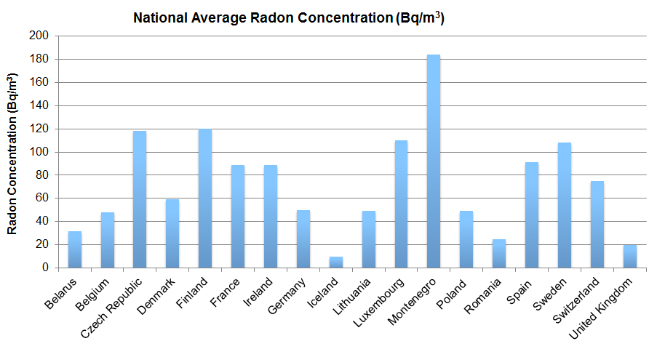
National Average Radon – UNSCEAR 2006
UNSCEAR 2006 Report: "Effects of ionizing radiation"
Notes:
This diagram and the next show the national average indoor radon level in homes in 30 countries in Europe (this slide) and around the world (next slide) based on an UNSCEAR 2006 report.
Source: UNSCEAR 2006, Effects of Ionising Radiation Volume II. Annex E

Slide 6
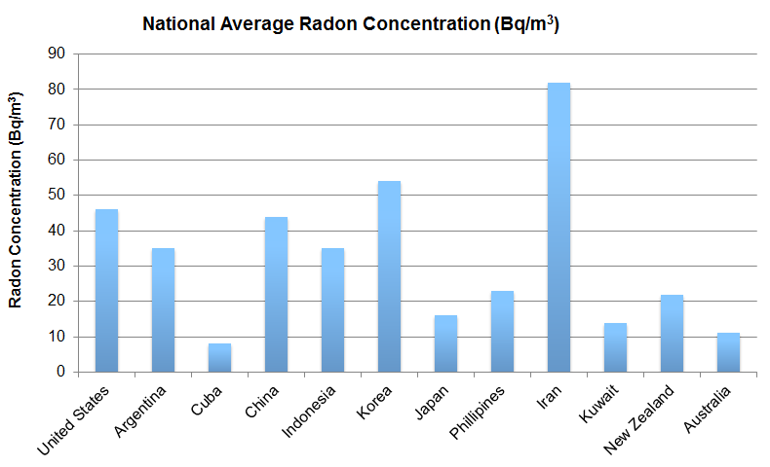
National Average Radon – UNSCEAR 2006 cont’d
UNSCEAR 2006 Report: "Effects of ionizing radiation"
Notes:
Source: UNSCEAR 2006, Effects of Ionising Radiation Volume II. Annex E

Slide 7
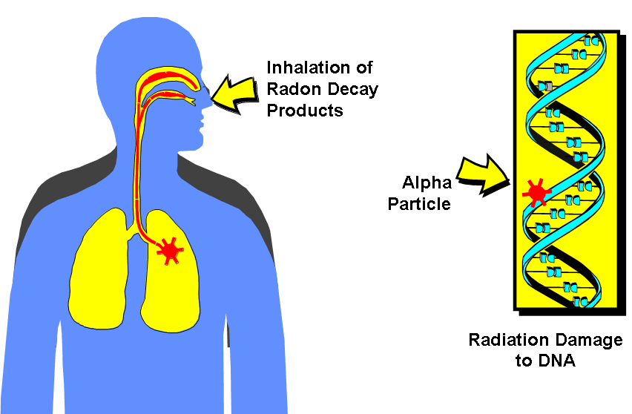
Health effects of radon exposure
When radon gas is inhaled, alpha particles from radon decay products can interact with biological tissue in the lungs leading to DNA damage.
Notes:
When inhaled, radon results in a radiation dose to the lung tissues and respiratory tract which may damage the lung and increases the risk of developing lung cancer.
When radon in air decays, it forms a number of short-lived radioactive decay products ('radon progeny'), which include polonium-218, lead-214, bismuth-214 and polonium-214. All are radioactive isotopes of heavy metal elements and all have half-lives that are much less than that of radon.
Radon gas itself does not directly cause lung cancer but the short-lived radon progeny, some of which remain suspended in air and attach to dust particles, adhere to the lung lining and through their radioactive decay emit alpha particles which can cause DNA damage in lung cells.
Radon progeny adhere to the sticky deposits found in the lungs of smokers thereby increasing the risk to smokers.
Only small amounts of radon progeny spread into the blood or other organs.
For each individual case of lung cancer there is no way of proving what caused it, whether it was the smoking habits of the patient or exposure to another factor such as passive smoking or radon.

Slide 8
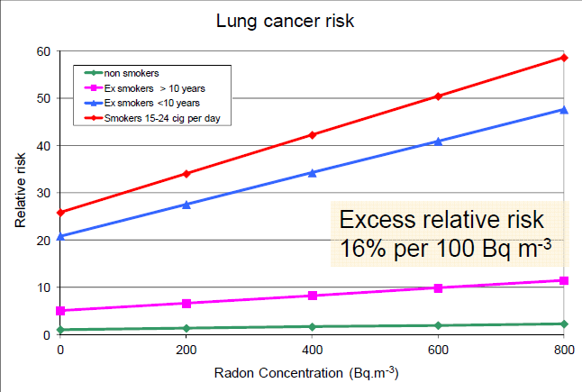
Relative risk of lung cancer
European pooling, Darby et al 2005, 2006.
A smoker of 1 pack of cigarettes per day has a 25 fold higher risk of lung cancer than a lifelong nonsmoker.
Notes:
This diagram shows the linear relationship between radon concentration and lung cancer risk due to radon. A separate relationship is shown for lifelong non-smokers, ex-smokers >10 years (former smokers who have ceased smoking for more than 10 years), ex-smokers <10 years (former smokers who have ceased smoking for less than 10 years) and current smokers who smoke 15-24 cigarettes per day.
The data show a greater lung cancer risk due to radon in smokers and ex-smokers.
The data also show that for smokers and lifelong non-smokers alike the excess risk due to radon increases by approximately 16% for every 100 Bq/m³ to which the person is exposed in their home.

Slide 9
Radiation dose from indoor radon: a comparison
Annual average radon concentration in the home | The radiation dose received is approximately equivalent to:
200 Bq/m³ | Less than one Chest X-ray per day
400 Bq/m³ | 1 Chest X-ray per day
800 Bq/m³ | 3 Chest X-rays per day
2 000 Bq/m³ | 7 Chest X-rays per day
Notes:
To put radon into context as a source of radiation exposure it is helpful to compare it with the dose from chest x-rays. These figures are approximate. While 1 chest x-ray may not seem significant – 1 chest x-ray every day would not be considered appropriate.
Living for 1 year in a house with radon concentration of 300 Becquerels per cubic meter (Bq/m³ ) results in effective dose of the order of 10 milliSieverts (mSv) which is equivalent to:
4 head CT scans,
25 years of exposure to average external background radiation, or
smoking 1 cigarette per day

Slide 10
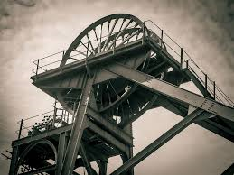
History of health effects of radon
Health effects of radon recorded in the 16th Century amongst miners in Central Europe
Lung cancer in 75% of miners from Schneeberg, Germany in the 19th century
1960: first epidemiological studies of miners identified a linear relationship between lung cancer risk and radon levels
1988: radon classified as human carcinogen by the International Agency for Research on Cancer (IARC)
In the 1980s and 1990s various epidemiological studies on lung cancer risk by residential radon were conducted in Europe, North America and China
2005: two large pooled epidemiological studies published – Darby (2005) and Krewski (2005)
Notes:
The health effects of radon exposures were observed and recorded as early as the 16th Century. The Swiss physician Paracelsus described a wasting disease of miners, the mala metallorum. Though at the time radon itself was not understood to be the cause. Neither radon nor radiation had yet been discovered. Also, the 16th century mineralogist Georgius Agricola recommended ventilation of mines to avoid this “mountain sickness” (Ref: Le radon, aspects historiques et perception du risque, Roland Masse)
In 1879, the "wasting" was identified as lung cancer in 75% of miners by Herting and Hesse in Schneeberg, Germany.
In 2004, the results of a joint analysis of 13 individual studies of residential radon exposure in nine European countries were published (Darby S., et al. (2004). Radon in homes and risk of lung cancer: collaborative analysis of individual data from 13 European case studies. British Medical Journal 330: 223-228).
The size of each of these studies on its own was too small to provide statistically significant results, but together they add up to the largest study of the risks of radon exposure in the home ever undertaken. The study analysed 7,148 lung cancer cases and 14,208 controls.
The principal conclusions were that the lung cancer increases by approximately 16% for every 100 Bq/m³ of radon exposure in the home. In addition, this risk seems to apply even at low radon concentrations, typically below the reference levels applied in a number of countries. Also, the lung cancer risk for active smokers was considerably higher than for lifelong non-smokers.
In early 2005, a comparable study undertaken in the United States analysis of pooled data from all North American residential radon studies reported similar results (Krewski D. et al. (2005). Residential radon and risk of lung cancer: a combined analysis of seven North American case-control studies. Epidemiology 16: 137-145).

Slide 11
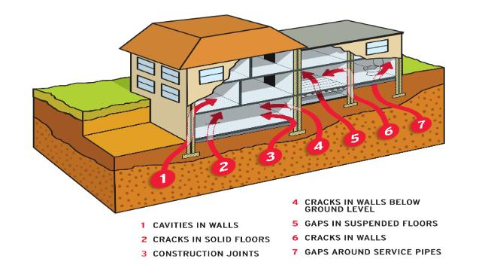
Radon pathways into buildings
Source: www.radon.ie (EPA Ireland)
Notes:
The principal route of entry of radon into buildings is through cracks in walls and foundations and gaps where services enter the building (for example, around waste/plumbing and electrical ducts).
Heating in the building can give rise to a lower air pressure within the building compared to the outside. This pressure differential may draw air laden with radon into the building.
Highly insulated homes which are not adequately ventilated can accumulate high levels of radon.

Slide 12
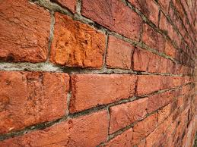
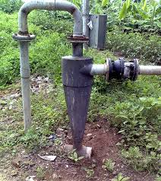
Other sources of radon in buildings
Building material
  Stones, bricks, tiles always contain some amount of radionuclides including radium.
  If the radium concentration is high, gamma radiation is also of concern.
  Radon releases from building material into the indoor environment.
Well water
  Radon dissolves in water in the geological environment.
  Radon is released from water during water use, mainly through showering.
  Radon is not a concern in surface water sources as the gas is released before it reaches the home.
  Ingestion of radon in water is not considered a health concern.
Notes:
Other sources of radon in homes are: (a) the building materials, including concrete, bricks, natural building stones, natural gypsum, and materials using industrial by-products such as phosphogypsum, blast furnace slag, and coal fly ash (EC 1999, Somlai et al. 2005); and (b) domestic and drinking water supply to the home.
Radon exposure from domestic drinking water out of drilled wells may occur either through ingestion or inhalation of radon released from water. The cancer risk resulting from the release of waterborne radon (showering, dish washing, etc.) is generally considered much greater than the risk from drinking water containing radon (WHO Guidelines on Drinking Water Quality, 2011).
Emanation of radon from building materials was found to be a problem in some areas due to the use of alum shale (to produce a light type of concrete) with enhanced levels of radium, and bricks, natural building stones, natural gypsum, and materials using industrial by products such as phosphogypsum, blast furnace slag, and coal fly ash (European Commission, 1999).
By 1978, houses were identified where the indoor radon concentrations were not associated with well water transport or emanation from building materials. Soil gas infiltration became recognized as the most important source of indoor radon. These other sources, including building materials and well water, are of less importance in most circumstances.

Slide 13
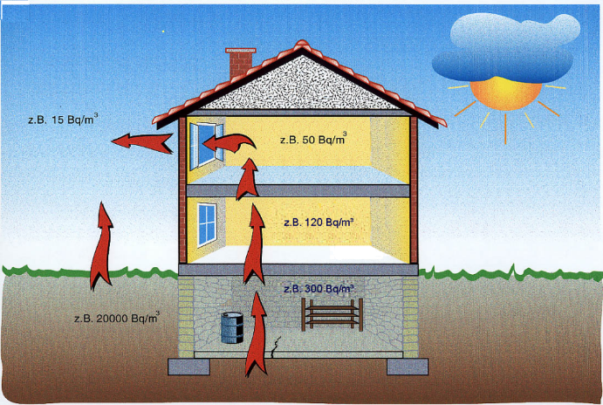
Radon levels in buildings
Radon levels indoors are influenced by:
Soil gas radon concentration
Soil permeability
Cracks and gaps in the structure
Level and type of heating/ventilation
Basement, ground, upper floors
Usage of the building including the habits of occupants
Season and weather
Source: BfS Germany
Notes:
This image gives sample data describing how the radon concentration in different levels in a building can compare to the soil gas concentration. Unoccupied buildings may accumulate radon due to lack of ventilation and lack of air mixing.
The level of radon in a building can only be determined by direct measurement.
Radon levels indoors are influenced by:
The radon concentration in soil gas around a home. This varies with geology with the result that some areas are more radon prone than others.
The presence of cracks and gaps in a building structure. The construction quality and type can affect the level of radon ingress, leading to radon prone buildings.
The level of heating in a building. Heating creates a pressure differential between the indoors and the outdoors which can cause the building to draw in soil gas laden with radon.
The level and type of ventilation. Ventilation dilutes the indoor air reducing the average level of radon. However, ventilation in upper floors can create a venturi or “stack” effect causing soil gas to be drawn in through lower floors.
The location in a house: basements and lower floors tend to have higher levels of radon mainly due to their proximity to the source and particularly if the quality of sealing is poor.

Slide 14
Temporal variation of indoor radon concentration
Source: BfS Germany
Notes:
The next two slides show seasonal and daily variations in radon levels in a building (source BfS, Germany).
Seasonal variations occur due to seasonal heating and ventilation habits. These variations must be taken into account when assessing indoor radon levels. For this reason, long-term measurements (over a year) are more representative and short-term measurements (taken over less than one season) should be used with caution.
Water logged soil can reduce the amount of soil gas released, while frozen soil in winter can direct soil gas to the path of least resistance, i.e. through the building.
See Module 5 which discusses measurement protocols.

Slide 15
Temporal variation of indoor radon concentration
Source: BfS Germany
Notes:
This slide shows daily variations in radon levels indoors due to occupant behaviour.
These variations must be taken into account when assessing indoor radon levels, particularly in buildings that are unoccupied for long periods (for example, schools regularly closed over the weekend).
These data also show the impact of occupant behaviour on the radon levels.
Decreases in radon concentrations are observed when windows and doors are opened showing the importance of ventilation.
However, it can also be seen that the decrease is only short term and there is a risk of increase in radon concentrations again when windows are closed.
See Module 5 which discusses measurement protocols.

Slide 16
Summary Learning Points
Radon is a radioactive, odourless, colourless, natural gas which comes from soil and rocks
Radon gas is a carcinogen and causes lung cancer
Lung cancer risk from radon is 25 times greater for smokers
Radon enters buildings through cracks and gaps in the structure
Radon levels can vary geographically due to geological features
Radon levels can vary within the building itself, as well as can fluctuate daily and seasonally
Radon exposure can be controlled to decrease the radon concentration and; therefore, the lung cancer risk. This will be addressed in Module 2.

Slide 17
Further Reading
International Atomic Energy Agency (2015). Protection of the Public against Exposure Indoors due to Radon and Other Natural Sources of Radiation. Specific Safety Guide. IAEA Safety Standards Series No. SSG-32.
World Health Organization (2009). Handbook on Indoor Radon: A Public Health Perspective, Geneva.
World Health Organization (2010). WHO guidelines for indoor air quality: selected pollutants, Copenhagen.
World Health Organization (2011). Guidelines for Drinking-water Quality, Geneva.
World Health Organization (2018). Management of Radioactivity in Drinking-water, Geneva.
International Agency for Research on Cancer (2012). Radiation. (IARC Monographs on the evaluation of carcinogenic risks to humans, Vol. 100D), Lyon.

Slide 18
Further Reading
Krewski D., et al. (2005). Residential radon and risk of lung cancer: a combined analysis of seven North American case-control studies. Epidemiology, 16: 137-145.
Darby, S., et al., (2004). Radon in homes and risk of lung cancer: collaborative analysis of individual data from 13 European case studies, British Medical Journal 330: 223-228.
European Commission (1999). Radiological protection principles concerning the natural radioactivity of building materials. Radiation Protection 112, EC, Luxembourg.

Slide 19
July 2018

